Slide 1







Tech Skills Requirements
Hutchful Nasiru
0ctober 2023

Slide 2



OUTLINE
Executive Summary
Introduction
Methodology
Results
Visualization – Charts
Dashboard
Discussion
Findings & Implications
Conclusion
Appendix

Slide 3

EXECUTIVE SUMMARY
Preferred tech stacks tends to affects the tech industry in many ways in the likes of ;
Programming languages
Databases
OS platforms
Individual preferences and company requirements drive these choices
There is rapid growth of certain stacks while there is rapid decrease in others
We are on a mission to remain competitive in the tech market hence the need to be updated to train our staff on emerging technologies

Slide 4

INTRODUCTION
Tech systems and tools are evolving over the years
The knowledge and skills posses by individuals in this setting cannot stand the test of time.
Hence there is the need for individuals and organizations to invest in keeping their systems and stakeholders updated
There are critical questions we should be asking ourselves in these circumstances;
What are the top languages and databases in demand
Are these languages and databases going to be relevant in future

Slide 5

METHODOLOGY
Sources for collection of data included;
Job postings requirements on platforms
Training portals
Surveys
Using the cluster method to identify relationships between the factors and key data involved in analysis
Gender involved
Type of jobs and education
Years of stack experience and locations

Slide 6

RESULTS

Slide 7
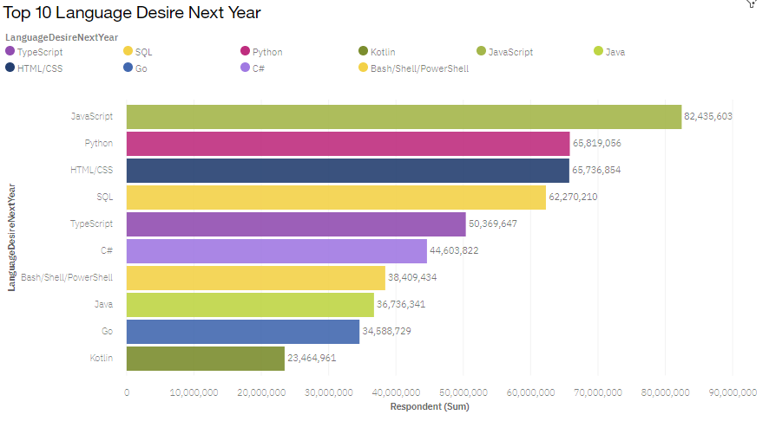
PROGRAMMING LANGUAGE TRENDS
Current Year
Next Year

Slide 8
PROGRAMMING LANGUAGE TRENDS - FINDINGS & IMPLICATIONS
Findings
JavaScript is the most used currently and most preferred in future
C++ is the least used language currently and appears no to be people’s top future choice
Python is one of the top choices and increased in future demand
Implications
JavaScript is the growing stack in the tech space
C++ is gradually losing its demand
Python is highly likely to become the most preferred stack in the field of programming

Slide 9
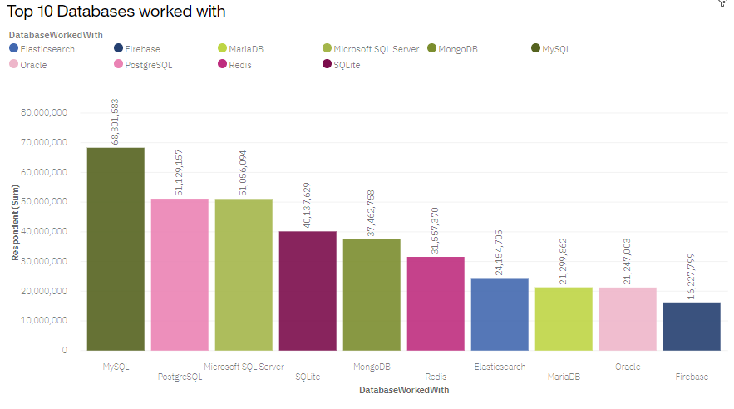
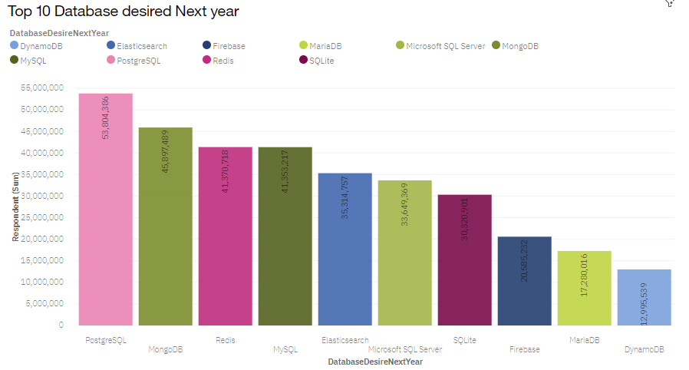
DATABASE TRENDS
Current Year
Next Year

Slide 10
DATABASE TRENDS - FINDINGS & IMPLICATIONS
Findings
MySQL is the most used currently which doesn’t to be in the interest of future preference
PostgreSQL is one of the top choices and increased in future demand
Implications
MySQL is the declining in the tech space demand
PostgreSQL is what people are gaining most interest in.

Slide 11

DASHBOARDS
Current Tech Trend Dashboard
Future Tech Trend Dashboard
Data Demographics Dashboard

Slide 12
Current Tech Trend Dashboard

Slide 13
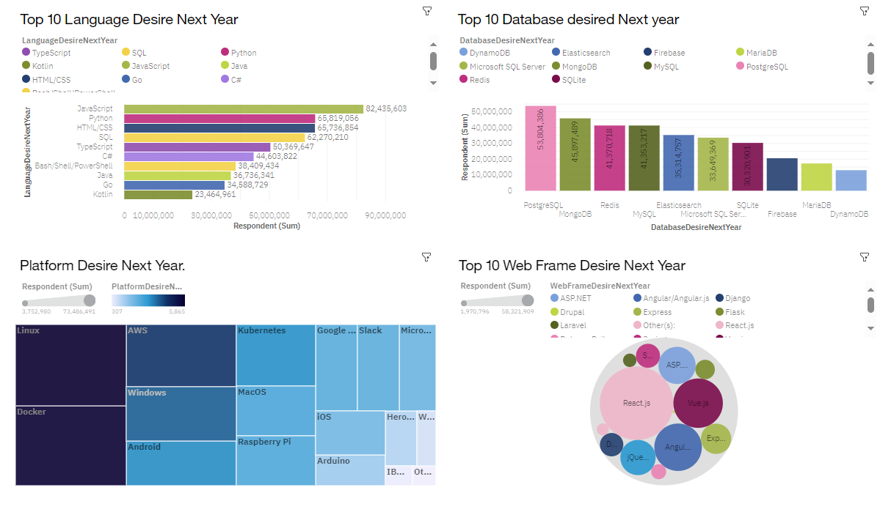
Future Tech Trend Dashboard

Slide 14
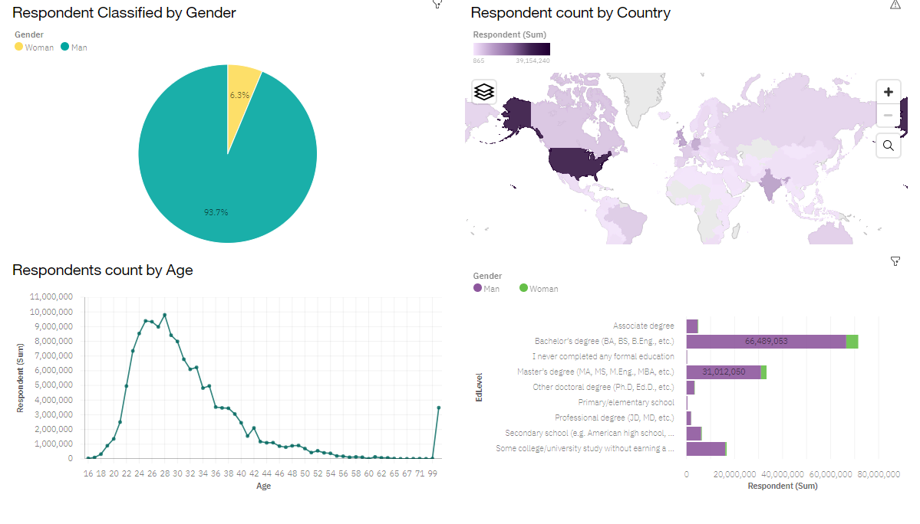
Data Demographics Dashboard

Slide 15
DISCUSSION
Seeing the implications of the general public’s choices, I think we know how to work on our inclination to a particular language

Slide 16

CONCLUSION
I propose stakeholders stay as diverse as possible when it comes to choosing a language or a database
Women should the given more space into tech as their numbers are low
The field of tech is filled with people in their mid 20s, hence recommend industries train teenagers

Slide 17

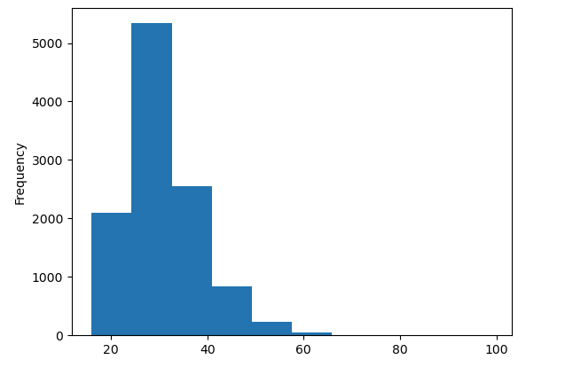
APPENDIX
This is the age group involvement of the survey .

